Slide 1
Plenary 8th November 2017

Slide 2
Running Order of Plenary
PPN Update- Katherine Peacock
Guest Speakers
Address to plenary- Colette Byrne
Overview of Community Section of LA- Michael Delahunty
Tourism Hubs – Brian Tyrrell
Yulefest – Paula Lawler
Networking Opportunity

Slide 3
PPN Representation
32 Representatives
Across 13 Strategic policy and oversight Committees
Representation across 3 Pillars
1 Disability representative seat – LCDC
1 Drugs Worker Specific Seat – SERDAF
3 Child/family representative seats – CYPSC
1 vacant seat for the Callan Friary Trust- Env. Rep
New P/T Administrator -Joan Kinsella

Slide 4
New Representatives to be Ratified
Representative | Group | Committee
John Hayes | Ferrybank Combined Residents Ass | Joint Policing Committee
Guy Jones | Irish Lebanese Cultural Foundation | Callan Friary Trust
Claire Henriques | Callan Variety Club | Callan Friary Trust
Anton Maizer | ISPCA | SPC 2 Transport
Declan Gibbons | Community Radio Kilkenny City | LCDC
Anne Corr | SOS Kilkenny | LCDC Disability Seat
Linda Tierney | IWA | SPC 4 Housing

Slide 5
Secretariat
8 members
No representation from the Environment Pillar- Rep resigned in 2017
Main Roles: Administrative body of PPN
Facilitate the implementation of the decisions of the Plenary.
Coordinate activities of PPN.
Act as a point of contact for the PPN in relation to the LA
Manage the PPN resource worker.

Slide 6
Working Groups/Linkage
Social Inclusion Pillar
11 Members meet monthly
Work to date:
Community Development
Com. Dev training – future proofing leadership
partnership with KLP 14 participants currently
on a 3 month non accredited course.
6 participants undertaking Degree in
Community Dev/Leadership and Social Enterprise

Slide 7
Social Inclusion Working group Continued:
Created a community Development Leaflet for Distribution
Housing: Met with Cllr Andrew Mc Guinness
Made a submission to the Housing Policy committee with recommendations for changes to working practices- on the agenda for next meeting

Slide 8
Environment Pillar Working Group
Meet as necessary
Workshop in August on the River Basin
Management Plan
Representation from SWAN Ireland & LAWCO
Made a comprehensive submission on the National Plan

Slide 9
Disabilities Working group
Working towards ‘Access for All’ Kilkenny
Feeds into the core committee –PPN Lead
Vision for Kilkenny Universal Access for All
Our community is strengthened by the inclusion of people from all walks of life.
All citizens of Kilkenny are entitled to equal opportunities for economic, social, cultural and community participation and “Universal Access for All” promotes an environment that contributes to this vision.
In partnership with all stakeholders we support social change that contributes to stronger, healthier communities for everyone.

Slide 10
Core Committee have recently put the development of a strategic plan out to tender – funded by the PPN
Next steps:
Workshop with all stakeholders*
Analysis of existing strategies to align the strategy to existing policy/practice
Development of a strategic plan with Actions/KIP/Partners
Development of an Educational Awareness programme for delivery to the business/community sectors – facilitated by service users

Slide 11
Further undertakings/representation by PPN & Members
National Planning framework 125 PPN Submissions (32 Groups)
Submission to SICAP Pobal Consultation for PPN
Submission to the Open Government Partnership – National Action Plan
Translated the PPN Information leaflet in Irish
6 Members attended the IRoute Transport Conference
7 MD meetings organised with LAWCO and Arts/ Libraries/ Heritage

Slide 12
1 representative attended the National Anti Poverty Workshop
2 attended Gender, Citizenship and Migration Conference
2 LCDC representatives attended National Training
Held 3 open training workshops for members
Supported 12 communities to hold a street feast celebration
Supporting 11 community events over Yulefest
Sponsoring a solidarity dinner

Slide 13
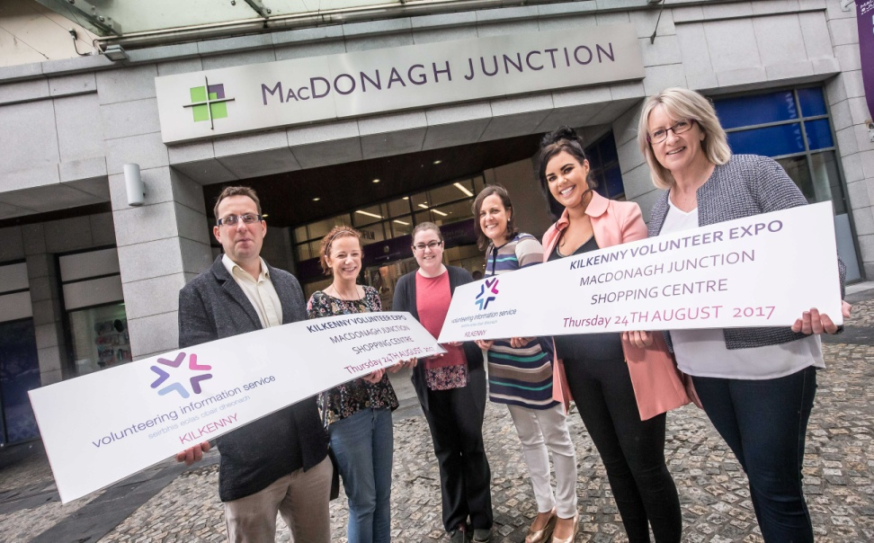
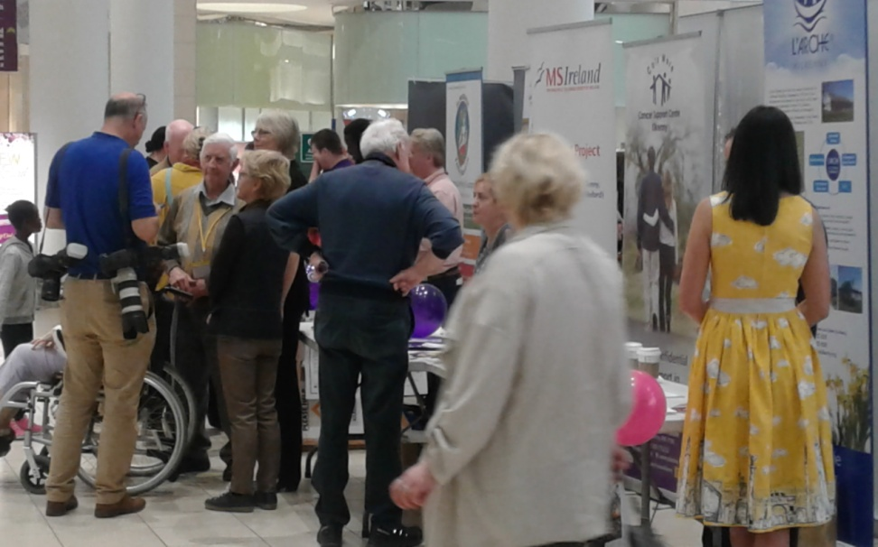
Volunteer Expo August ‘17
Volunteer Service/PPN
20+ Exhibitors 200 Visitors

Slide 14
Representative Questionnaire 50% response rate
Findings
Majority of reps felt they were treated equally on committees
Majority of reps felt that they were invited to contribute at committee meetings and listened to
Over all Positive experiences
reported
Training requirements
Making a submission
Understanding Local Government Structures
Training planned for early 2018
The wheel
Enhancing the effectiveness of PPN reps

Slide 15
Queries/Comments
Forms on you table
Representatives- fill in training availability
Questions that you would like to pose to the
PPN
Expression of interest in Community
Development Training
Join a working group
Like to be contacted for the ‘Access for All’ workshop

Slide 16
Available for any questions after the guest speakers
Thank you for your attention and support of the PPN

