Slide 1
Electric Vehicle (EV) Presentation
Paddy Phelan BE MIEI CPM CMVP
Manager of Carlow Kilkenny Energy Agency (CKEA)

Slide 2
International Context Electro-Mobility
Electric vehicle (EV) is a term used to describe a transport vehicle that is solely or jointly propelled by an electric motor, in particular Battery Electric Vehicles(BEV) do not have a combustion engine as found in a typical car on the road.
Electro-mobility offers an unequalled solution to make Europe’s transport more efficient, less dependent on imported energy, low carbon, clean and quiet. Specifically, the electrification of surface transport will enable Member States to meet their greenhouse gas emission reduction targets for 2030 and to address the public health crisis arising from urban air pollution.

Slide 3
Vehicle Sales
Total Car Sales Jan-May 2017
Total Sales EV - 2017
Total May 2017 | 5,991 | 89,791
Total May 2016 | 6,499 | 99,704
2017 change 2016 | -508 | -9,913
% change 2017 - 2016 | -7.82% | -9.94%
Ireland | 2017 | %
Nissan Leaf | 95 | 44
Hyundai Ioniq Electric BMW 330e Volvo XC90 T8 Mitsu. Outlander PHEV | 69 18 14 5 | 32 8 7 2
VW Golf GTE | 3 | 1
Renault Zoe BMW i3 BMW X5 40e | 2 2 2 | 1 1 1
Porsche Panamera PHEV | 1 | 0
Mercedes S500e VW Passat GTE BMW 740e Volkswagen e-Golf | 1 1 1 1 | 0 0 0 0
TOTAL | 215 | 100

Slide 4
EV Charging
3 different charging infrastructure:
Domestic (3.7 kW single-phase, charge time 6-8 hrs)
Public charging point (11-22 kW 3-phase, charge time 1-6 hrs)
Fast charging, (50 kW 3-phase, 80% charge time 20-30 min, installed mainly on inter-urban routes)
Free charging of EV from public EV charging point
Domestic charging can utilise night rate electricity to charge EV at lower price.
County | No. of Charging Station
Kilkenny | 8
Carlow | 7
Wexford | 16

Slide 5
Integrated Energy Storage
Charging facility requires electrical energy storage capacity, especially fast charging.
Current CO₂ emission from grid electricity is higher than petrol/diesel (494 g CO₂/kWh compared to 252/264 g CO₂/kWh)
On-site renewable electricity generation can be used to supply energy (partly) to the EV through the use of energy storage systems, reducing carbon footprint.
PV with battery system is suitable for this application (note the DC-DC process from PV to battery to EV battery) - Gaelectric Portview House PV with Tesla Powerwall battery ESCO project.

Slide 6
Financial Benefits of EV
Max grant of €5,000 for private purchase.
Max grant of €3,800 for commercial purchase.
Max VRT relief of €5,000.
100% asset write down in year 1 under Accelerated Capital Allowance (ACA) scheme.
Currently free charging of EV from public EV charging point.
Higher efficiency than internal combustion engine (59-62% vs 17-21%)

Slide 7
CKEA EV Business Case

Slide 8
Current Situation
Travel for work expenses €/km travelled
Rate €0.59/km up to 6,437km
Rate €0.29/km beyond 6,437km
Existing Statistics
12 different car makes and models
CKEA Annual mileage ➔ 41,403km
Annual cost ➔ €23,426
Carbon footprint ➔ 6 tonnes CO2
520 round trip journeys from Carlow to Kilkenny

Slide 9
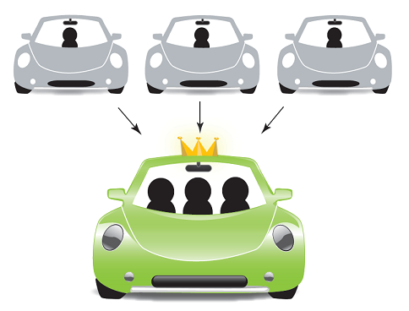
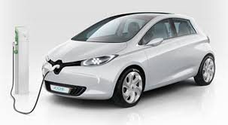
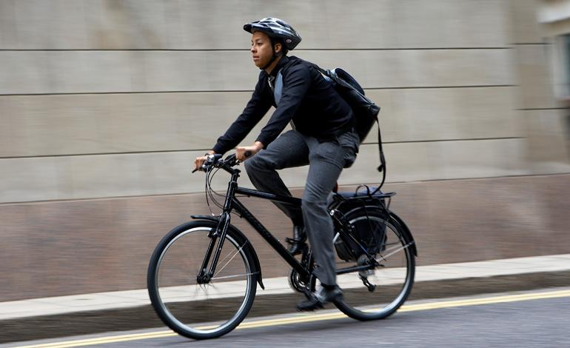
Fuel & Emissions savings
Options
Cycle to work scheme
Car Pooling
Electric Vehicle
Notes:
The total quantity of fuel consumed in thermal power stations reduces as the penetration of wind generation increases
This also has a corresponding effect of reducing green house gas emissions
The associated value of the fuel and emissions cost saving depend on fuel and carbon prices. The higher the price of carbon and fuel the greater the savings will be

Slide 10
Fuel & Emissions savings
EV Options
Make | Model | Range (km)
BMW | i3 | 156-290
Mitsubisshi | i-MiEV | 100-160
Nissan | e-NV200 | 117-200
Nissan | Leaf | 117-200
Tesla | Model S | 390-539
Hyundai | Ioniq e | 169-250
Renault | Zoe | 210-400
Notes:
The total quantity of fuel consumed in thermal power stations reduces as the penetration of wind generation increases
This also has a corresponding effect of reducing green house gas emissions
The associated value of the fuel and emissions cost saving depend on fuel and carbon prices. The higher the price of carbon and fuel the greater the savings will be

Slide 11
Fuel & Emissions savings
Analysis was carried out for a fully electric vehicle with a range to comfortably complete and round trip journey with 150km.
CKEA Total km travelled in 2016 =<150km | 18,872km
Total Cost Savings (€) | €11,135.00
Charging Point Cost | €0.00
Estimated Annual Insurance | €1,000
Estimated Annual Car maintenance | €250.00
Annual Motor Tax | €120.00
Useful Cost Savings (€) | €6,613.00
Vehicle Cost (€) for 5 year simple payback | €33,065.00
Notes:
The total quantity of fuel consumed in thermal power stations reduces as the penetration of wind generation increases
This also has a corresponding effect of reducing green house gas emissions
The associated value of the fuel and emissions cost saving depend on fuel and carbon prices. The higher the price of carbon and fuel the greater the savings will be

Slide 12
Fuel & Emissions Benefit

Slide 13
Conclusion
Analysis was carried out for a fully electric vehicle with a range to comfortably complete and round trip journey with 150km.
CKEA Total km travelled in 2016 =<150km | 16,454
Useful Cost Savings (€) | €6,613.05
Vehicle Cost (€) for 5 year simple payback | €33,065
Leasing options | €6,613/year
Co2 emission savings | 5,666 kgCo2

